Slide 1

Bitcoin: A New Internet Currency
The opinions expressed are solely those of the presenters and do not reflect the opinions of the Federal Reserve Bank of Dallas or the Federal Reserve System.

Slide 2
What is Bitcoin?
A peer-to-peer internet currency that allows decentralized transfers of value between individuals and businesses.

Slide 3

Bitcoin vs. bitcoins
Bitcoin is the system
bitcoins are the units

Slide 4

Creating a currency from scratch
Motivation
Distrust of financial institutions
Transaction costs
Primary concerns
Transaction security
Double spends

Slide 5
Distrust of financial institutions
Any noncash transaction requires a trusted third-party administrator—commonly a bank or financial service provider.
The system forces participants to trust financial institutions that are not always trustworthy.

Slide 6
Transaction costs
Traditional payments are revocable, even on irrevocable services.
Financial institutions act as an arbitrator between counterparties in disputed claims.
Arbitration costs are passed on to consumers.

Slide 7
Transaction security
Two levels of verification
Source is legitimate
Coins are legitimate
Public/private key verification ensures the legitimacy

Slide 8
Double spends
If the money is just digital codes, why not copy and paste to make more money?
Timestamps
Hashes
Block chain

Slide 9
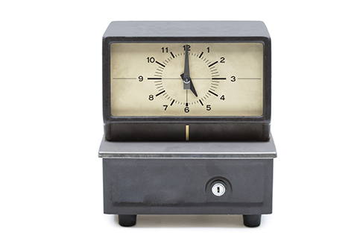
Double spends
Timestamp
Each transaction is packaged and publically recorded in the order it was carried out.
Hash
The time-stamped group of transactions are given a unique algorithmically derived number

Slide 10
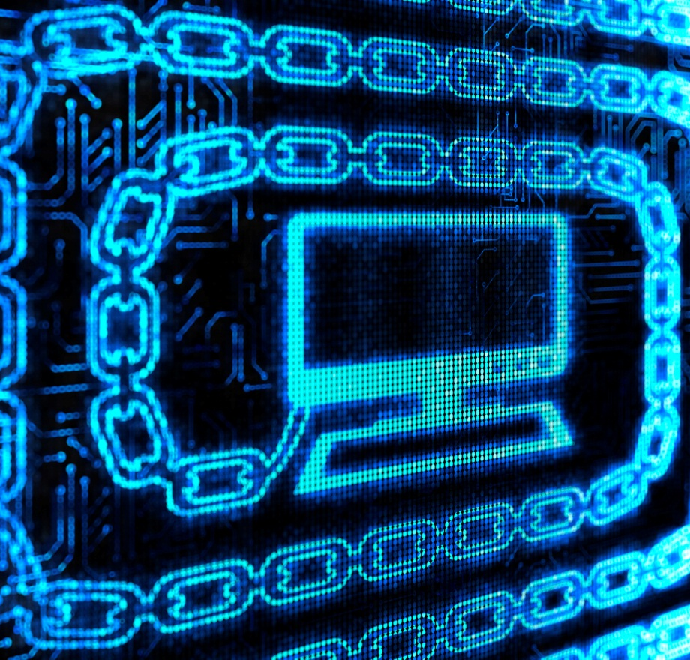
Double spends
Block chain
Transactions are recorded in a community-built record of all transactions that acts as a proof-of-work.
Computers connected to the network accept the longest chain as accurate.

Slide 11
Where do bitcoins come from?
They’re mined, silly.
High-powered computers solve complicated math problems.
Each time a problem is solved, the finder is paid a bounty.

Slide 12
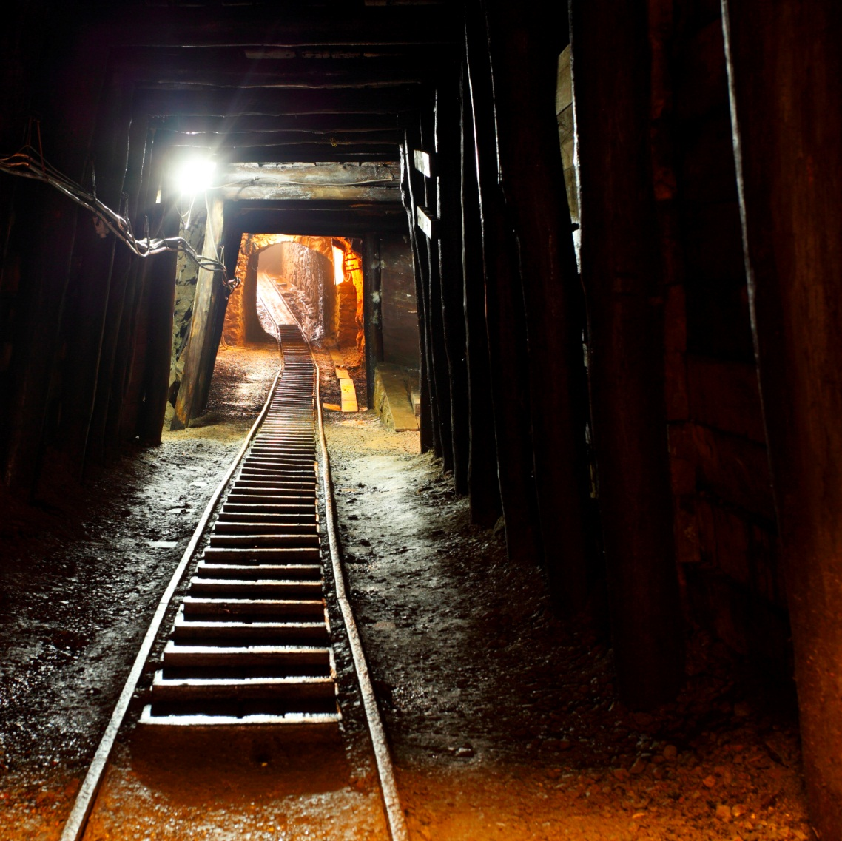
Mining bitcoins
Miners solve complicated algorithms to find a solution called a hash.
Finding a hash creates a block that is used to process transactions.
Each new block is added to the block chain.

Slide 13
Mining bitcoins
Until there are 21 million bitcoins, miners are paid for finding a hash in new coin.
After 21 million, miners will charge transaction fees for creating a new block.
The amount paid per hash goes down by half about every 4 years.

Slide 14
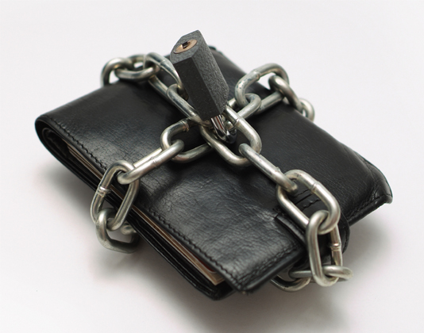
Owning bitcoins
Users create accounts called wallets.
Wallets are secured using passwords and contain the private keys used for transferring bitcoins.

Slide 15
Spending bitcoins
Seller provides an address to the buyer
Buyer enters the seller’s address and the amount of the payment to a transaction message
Buyer signs the transaction with a private key and announces the public key for verification
Buyer broadcasts the transaction to all the Bitcoin network

Slide 16
Bitcoin security
Computers accept the longest block chain, which inhibits hacking.
Hackers would have to create a longer chain of fraudulent information faster than the combined effort of all other computers.
Public/private cryptography means individual bitcoins are secured when not being transacted.

Slide 17
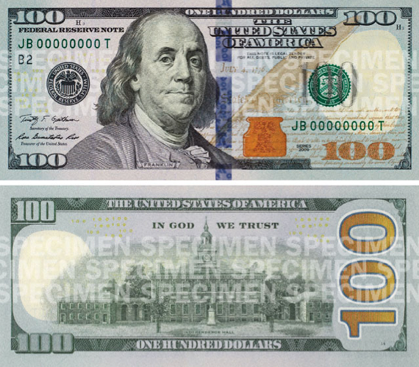

Is it money?
Store of value
Medium of exchange
Unit of account

Slide 18
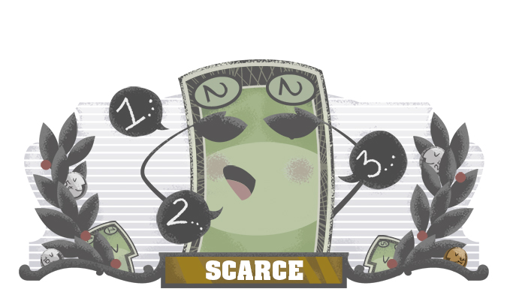
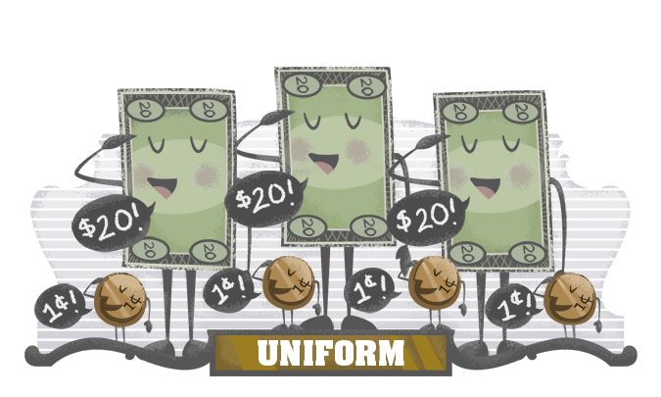
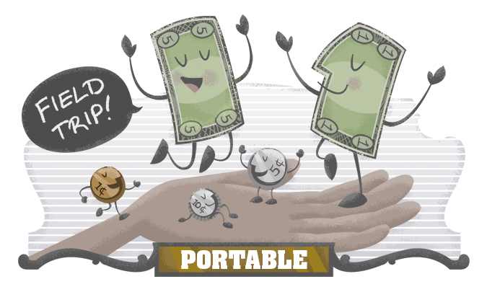
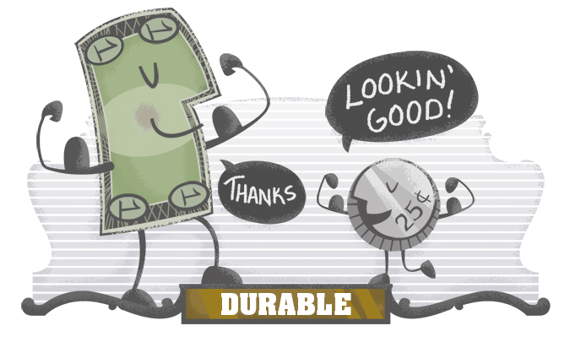
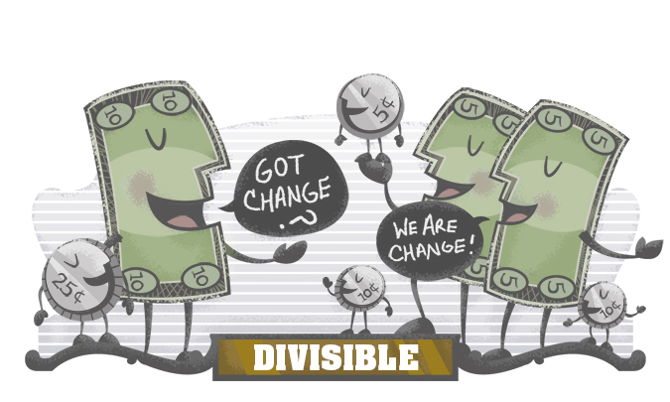
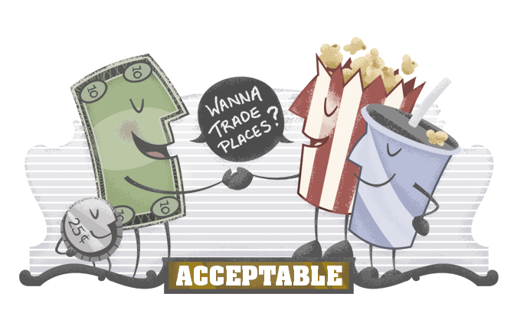
Is it money?

